Slide 1


HOW A DEV TEAM WORKS

Slide 2
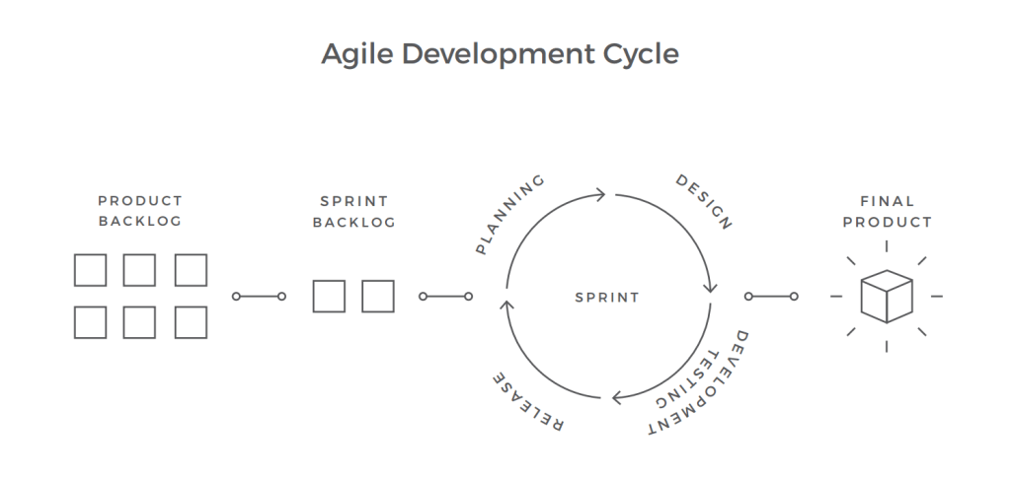
AGILE
an iterative approach to project management and software development that helps teams deliver value to their customers faster and with fewer headaches
Team delivers work in small, but consumable, increments instead of betting everything on a "big bang" launch.

Slide 3
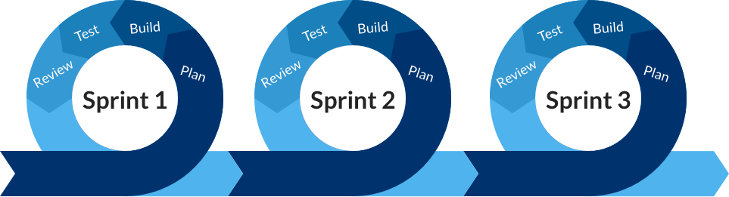
SPRINT
a short, time-boxed period when a scrum team works to complete a set amount of work
are at the very heart of scrum and agile methodologies, and getting sprints right will help your agile team ship better software with fewer headaches

Slide 4

USER STORIES
short requirements or requests written from the perspective of an end user.

Slide 5
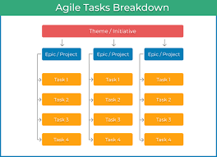
EPICS
large bodies of work that can be broken down into a number of smaller tasks (called stories)

Slide 6
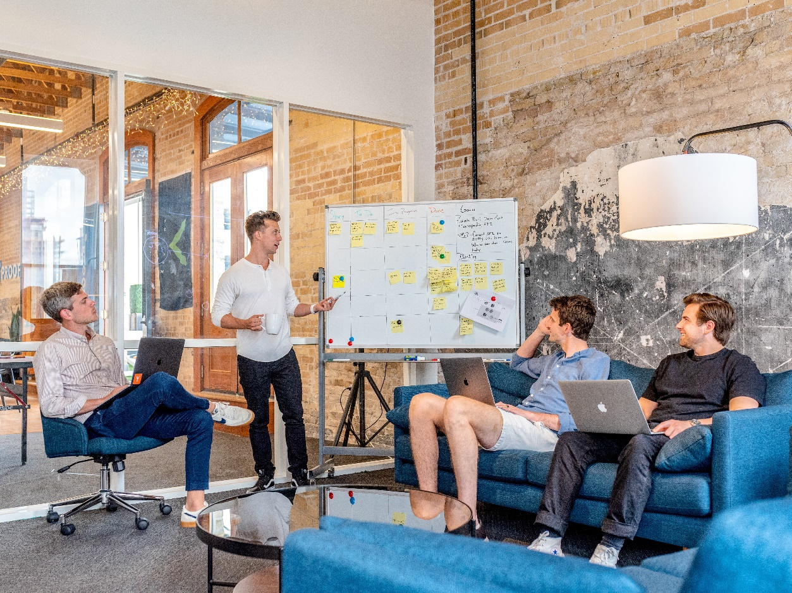
THE AGILE TEAM

Slide 7
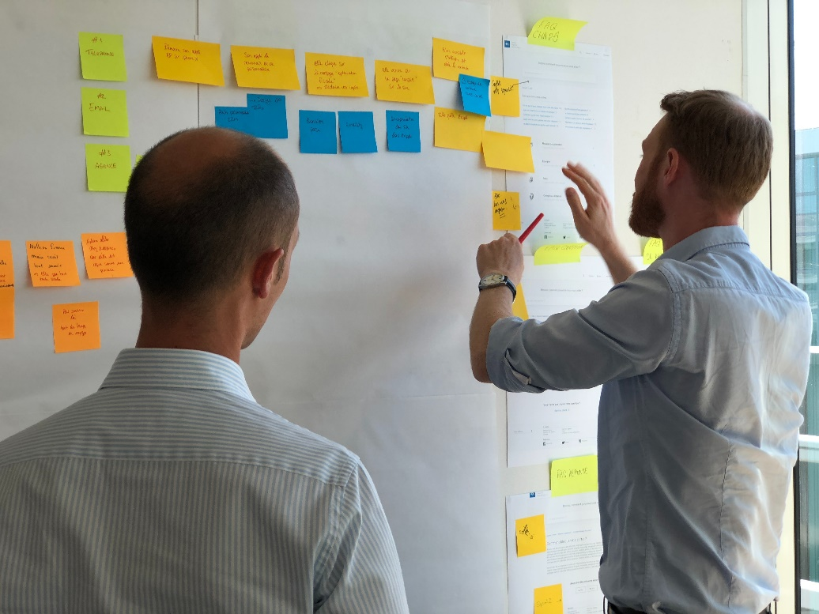
PRODUCT OWNER
A member of the Agile Team responsible for defining Stories and prioritizing the Team Backlog to streamline the execution of program priorities while maintaining the conceptual and technical integrity of the Features or components of the team
the customer proxy responsible for working with Product Management and other stakeholders—including other POs—to define and prioritize stories in the Team Backlog

Slide 8

SOFTWARE DEVELOPER
the creative, brainstorming masterminds behind computer programs of all sorts
Applications software developer - responsible for designing computer or mobile applications whose nature of work is largely focused on creating for consumers involving understanding user needs, developing software solutions, monitoring performance and modifying programs as needed
Systems software developer - focused on operating systems-level software, compilers and network distribution software role is geared more toward designing solutions for enterprise organizations including developing software for medical, industrial, military, communications, aerospace, business, scientific and general computing applications

Slide 9

QUALITY ASSURANCE ENGINEER
tracks the development process of a product from start to finish
oversees production, testing each part to ensure it meets company standards before moving to the next phase
Goal: to create safeguards for products to be market-ready and meet all government regulations before it is released to the public

Slide 10
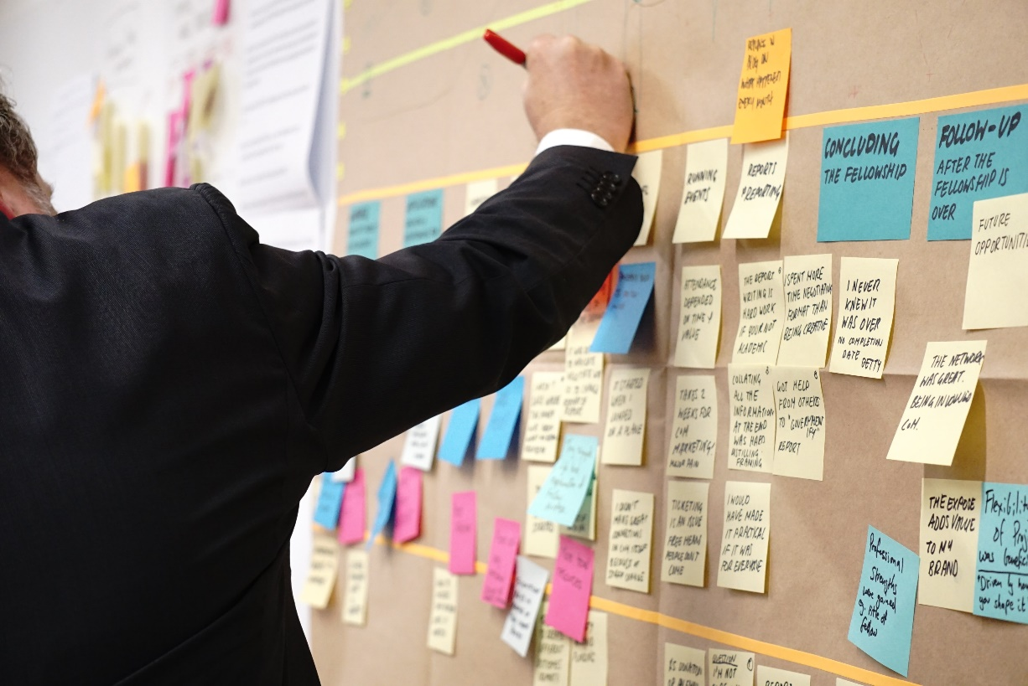
KANBAN BOARD
An agile project management tool designed to help visualize work, limit work-in-progress and maximize efficiency (or flow)
Uses cards, columns, and continuous improvement to help technology and service teams commit to the right amount of work, and get it done

Slide 11
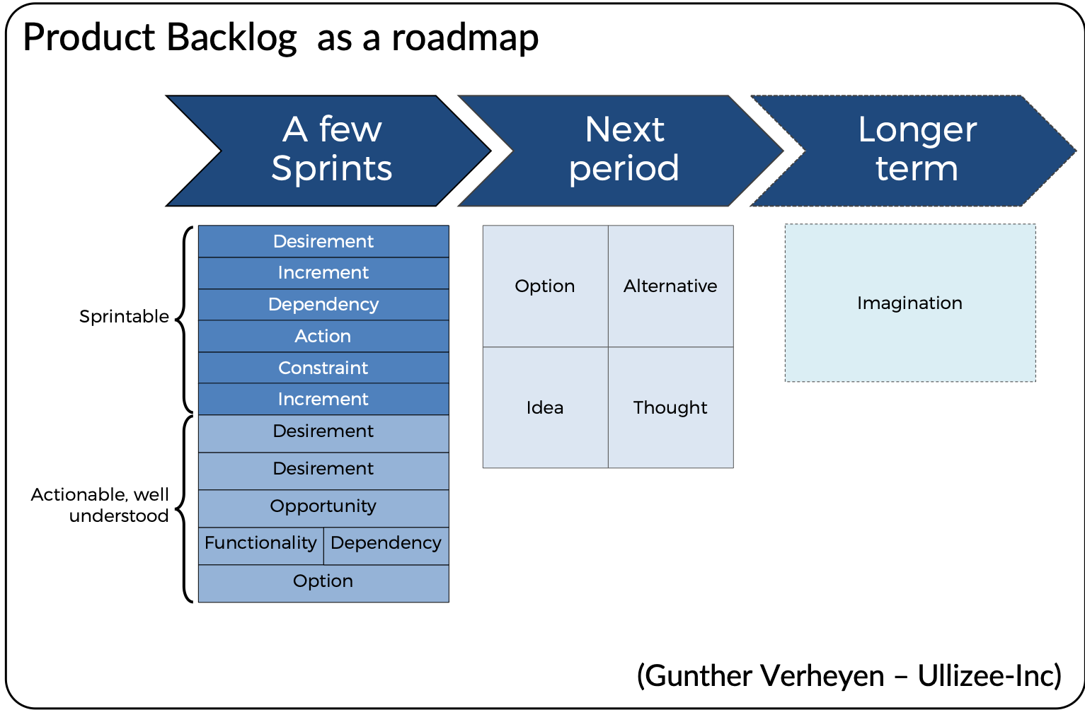
PRODUCT BACKLOG
a prioritized list of work for the development team that is derived from the roadmap and its requirements

Slide 12
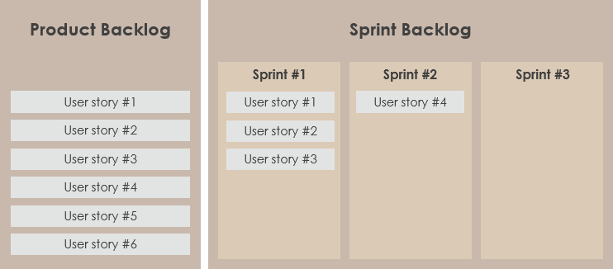
SPRINT BACKLOG (TO DO)
like a subset of the product backlog
comes from the product backlog, but it contains only that item, or those items, that can be completed during each agile sprint

Slide 13

In PROGRESS
Tasks we are doing

Slide 14
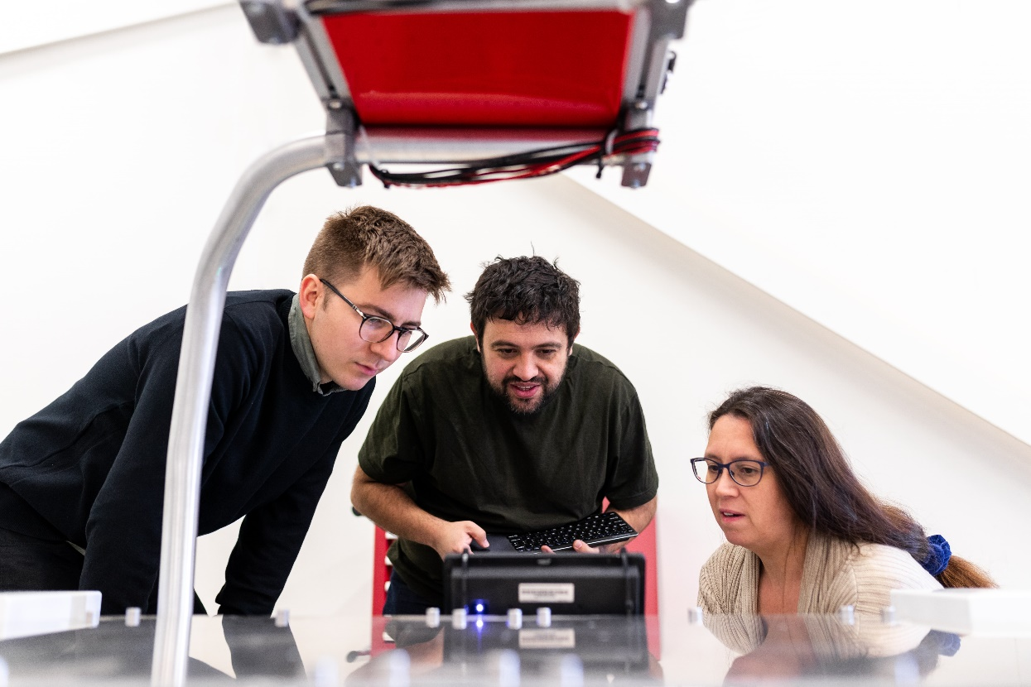
SOFTWARE TESTING
a method to check whether the actual software product matches expected requirements and to ensure that software product is Defect free

Slide 15

DONE
Completed tasks

Slide 16
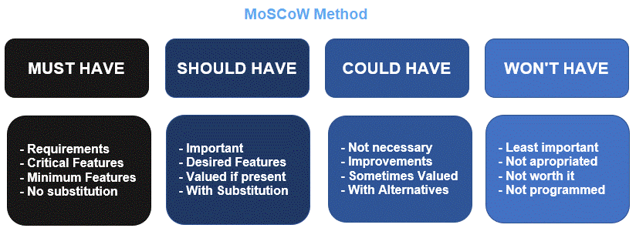
MosCOW METHOD
MoSCoW method (a.k.a. MoSCoW prioritization and MoSCoW analysis) is a popular prioritization technique for managing requirements.
MoSCoW represents four categories of initiatives: must-have, should-have, could-have and won’t-have.

Slide 17
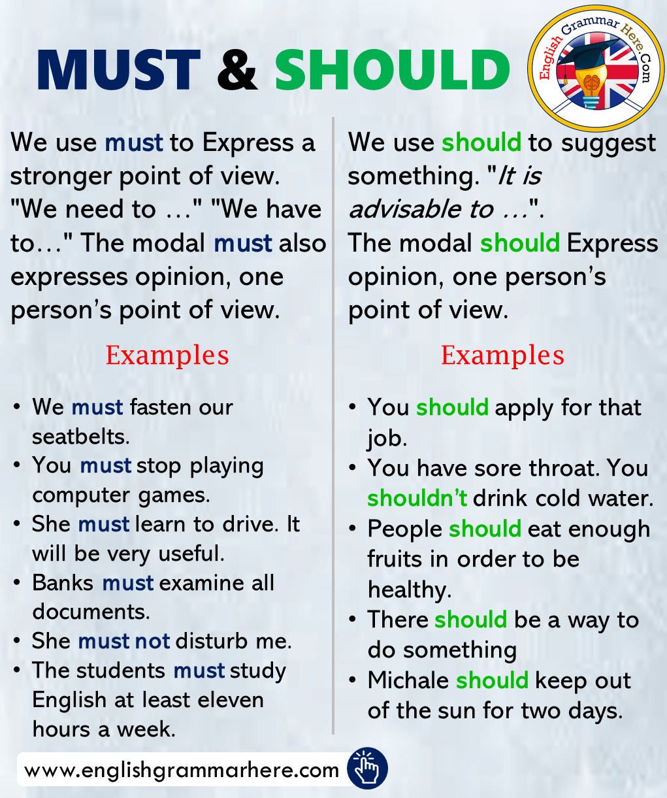
MUST
SHOULD
Non-negotiable needs for the project, product or release in question
Requires the team to complete a mandatory task
Essential to the project, product or release but not vital
Can get scheduled for a future release without impacting the current one
If left out, the project or product still functions.

Slide 18
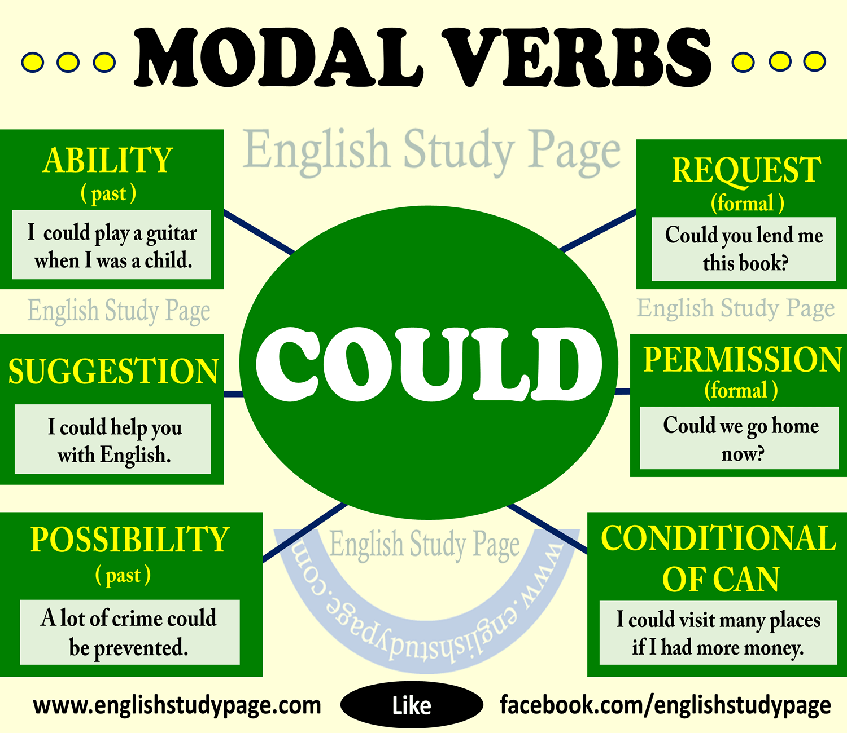
COULD
Nice to haves, not necessary to the core function of the product
Compared with should-haves, they have a smaller impact when left out.
However, the initiatives are often to be first deprioritized if a task in the “should have” or “must have” category ends up larger than expected.

Slide 19

WILL NOT (WON’T) HAVE (FOR NOW)
Can manage expectations about what the team will not include in a specific release (or another timeframe you’re prioritizing)

Slide 20
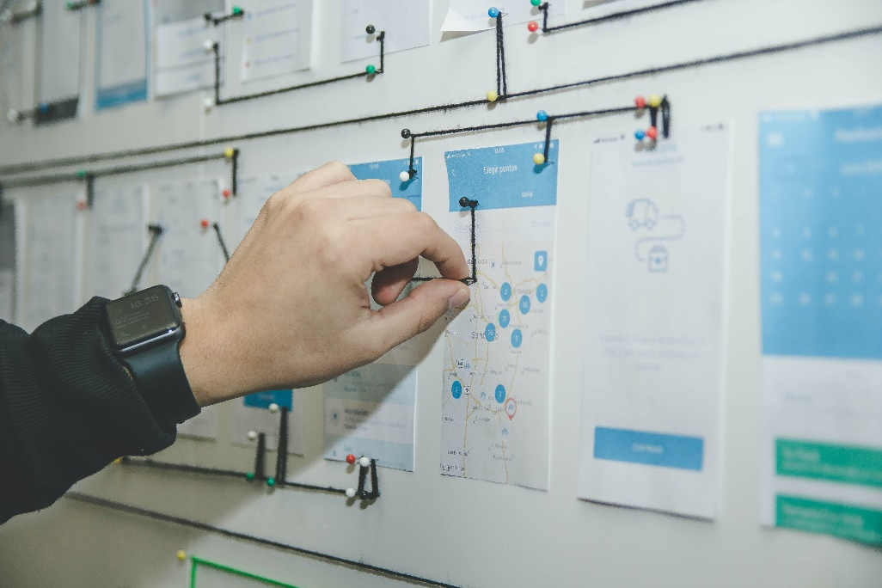
SPRINT PLANNING
first day of a new sprint
an event in the Scrum framework where the team determines the product backlog items they will work on during that sprint and discusses their initial plan for completing those product backlog items

Slide 21
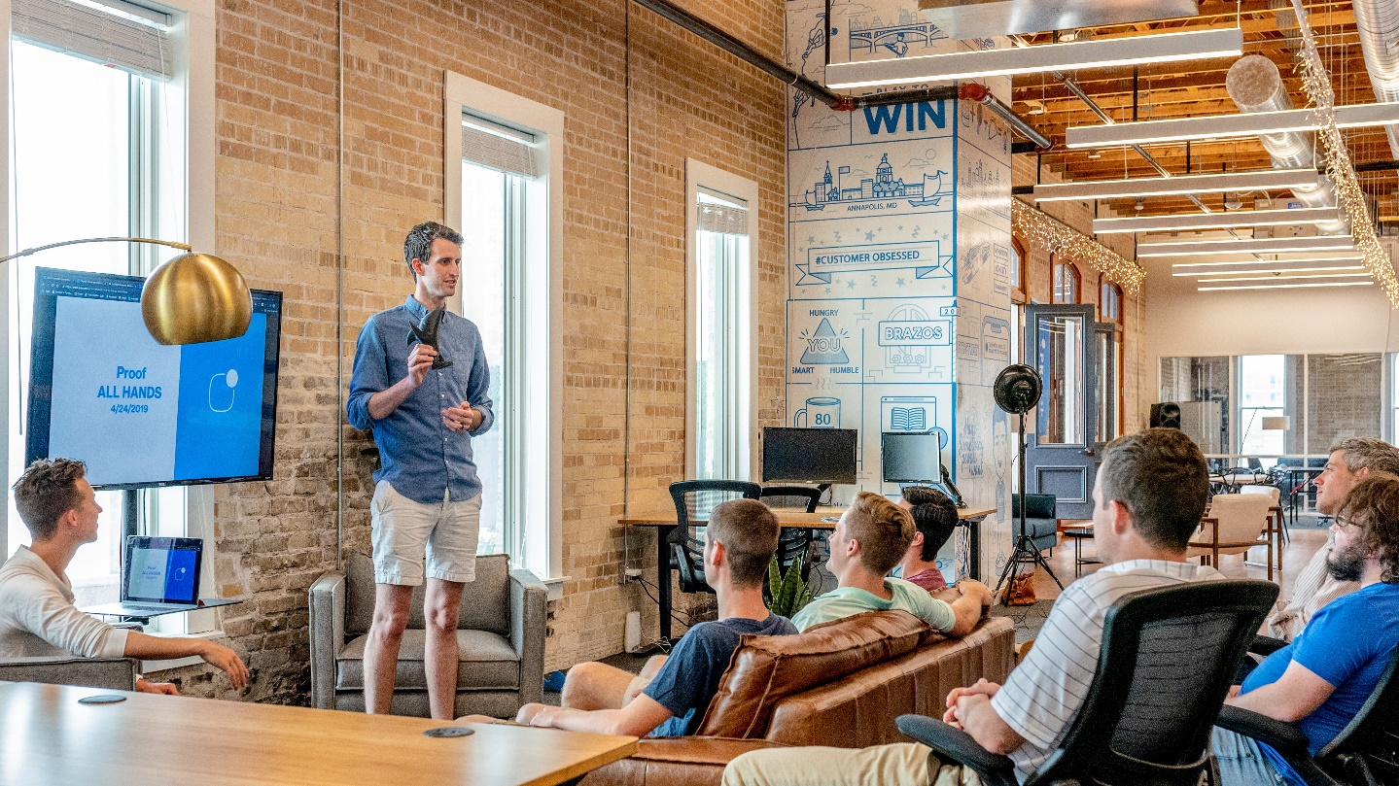
STAND-UP MEETING
a short meeting between a team that is held on foot (usually 5 – 15 minutes)
Goal: to go over important tasks that have been finished, are in progress, or are about to be started

Slide 22
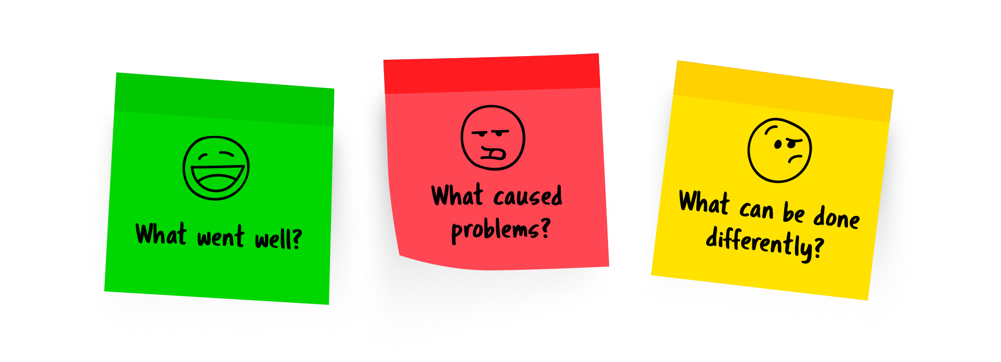
SPRINT RETROSPECTIVE
a recurring meeting held at the end of a sprint used to discuss what went well during the previous sprint cycle and what can be improved for the next sprint

Slide 23

“I alone know the plans I have for you, plans to bring you prosperity and not disaster, plans to bring about the future you hope for.”
- Jeremiah 29:11 (Good News Translation)

Slide 24
SOURCES
https://kanbanize.com/blog/running-a-better-stand-up-meeting/
https://www.agilealliance.org/glossary/sprint-planning/
https://www.atlassian.com/agile
https://www.atlassian.com/agile/kanban/boards
https://www.atlassian.com/agile/scrum/backlogs
https://www.atlassian.com/agile/scrum/sprints
https://www.digite.com/kanban/what-is-kanban/
https://www.atlassian.com/agile/project-management/epics-stories-themes
https://www.guru99.com/software-testing-introduction-importance.html
https://www.productplan.com/glossary/moscow-prioritization/
https://www.projectmanager.com/blog/product-backlog-sprint-backlog
https://www.rasmussen.edu/degrees/technology/blog/what-does-software-developer-do/
https://www.scaledagileframework.com/product-owner/
https://www.ziprecruiter.com/e/What-Do-Quality-Assurance-Engineers-Do

